Slide 1

RUNGTA COLLEGE OF DENTAL SCIENCES & RESEARCH
TITLE OF THE TOPIC- DIE MATERIALS
DEPARTMENT OF CONSERVATIVE DENTISTRY AND ENDODONTICS

Slide 2
Specific learning Objectives
At the end of this presentation the learner is expected to know ;
Core areas* | Domain ** | Category #
Introduction | Cognitive | Must know
Method | Psychomotor | Must know
Armamentarium | Cognitive | Must know
*Subtopic of importance
** Cognitive, Psychomotor or Affective
# Must know , Nice to know & Desire to know
( Table to be prepared as per the above format )

Slide 3

CONTENTS
    Introduction
    Ideal requisites of die materials
    Classification of die materials
    Different die materials
    Different die systems
    Conclusion
    References

Slide 4
Electroplated Dies / Electroformed Dies :
Used to overcome the poor abrasion resistance of gypsum.
Advantages
High strength,
Hardness
Abrasion resistance.
The time required to produce a cohesive film of metal typically 8 hrs

Slide 5
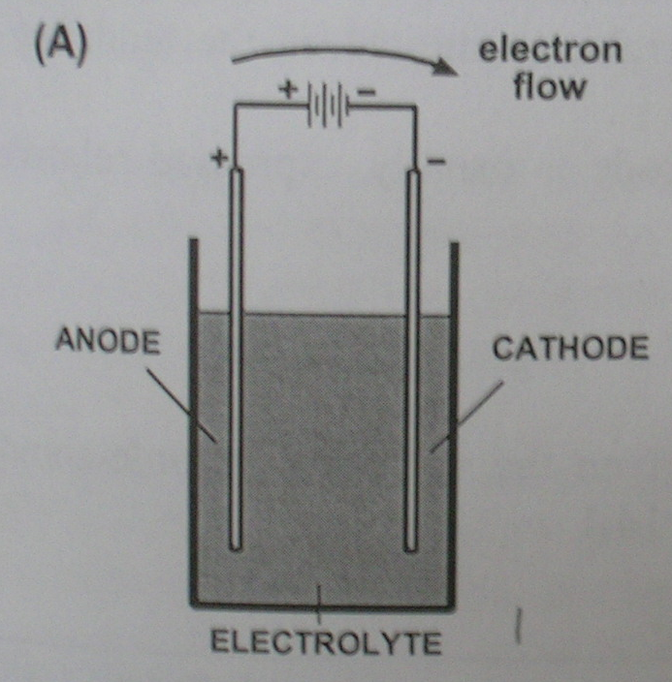
ELECTROLYTIC CELL

Slide 6
Because of their low energies, silicone impression materials are difficult to electroplate evenly.
Polyether impressions, because of their hydrophilic nature, imbibe water and become distorted.
Polysulfide polymers can be silver plated, but it is more difficult to copper plate them. The

Slide 7
The first step in the procedure is to treat the surface of the impression material so that it conducts electricity.
This process is referred to as METALLIZING.
In this process, a thin layer of metal, such as silver is deposited on the surface of the impression material.

Slide 8
Metallizing agents are :
Bronzing powder suspended in almond oil
Aqueous suspensions of silver powder
Powdered graphite
Requirements for electroplating :
The impression to be coated is made the cathode.

Slide 9
Anode is the metal to be deposited either silver or copper
Anode and cathode holder.
Electrolyte is the solution through which the electric current is passed.
The ions are deposited from the anode to the cathode.

Slide 10
COMPOSITION OF ELECTROPLATING BATH :
Copper :
Copper sulfate (crystals) – 200g
Sulfuric acid (concentrated) – 30 ml
Phenosulfonic acid – 2 ml
Water (distilled) – 1000 ml
Silver :
Silver cyanide – 36g
Potassium cyanide – 60 g
Potassium carbonate – 45g
Water (distilled) – 1000ml

Slide 11
AMMETER :- The current passed is of 10ma / tooth area for 12 hrs. It should not exceed 50ma.
Plating tank – glass or hard rubber with well fitting cover to prevent evaporation.

Slide 12
PROCEDURE :
a) Copper plating :
* The surface of the impression is rendered conductive by coating it with fine particles of copper or graphite.
* The coated impression is made the cathode (negative electrode) of a plating bath, with an anode (positive electrode) of copper.

Slide 13
* The electrolyte is an acid solution of copper sulfate (about 250g/l.
* A current is passed, causing slow dissolution of the anode and movement of copper ions from anode to cathode, so plating the impression.

Slide 14
Dental stone is then cast into the plated impression.
The technique is often not considered suitable for the elastomeric materials.
b) Silver plating :
Polysulfide and silicone impression materials can be silver plated by the same general technique except
The impression is coated with silver or graphite powder.
The anode is silver.
The electrolyte is an alkaline solution of silver cyanide

Slide 15
Problems in metal-forming : Due to
Faulty conduction
Exhausted solution
Over concentrated solution
Metal anode too small
Friable metal deposit

Slide 16
POLYMERIC MATERIALS :
Auto-polymerising acrylic : Although self-cure acrylic polymers are often recommended for use as die materials,
Disadvantages.
The monomer reacts with all except silicone impression materials.
The heat of reaction distorts thermoplastic materials.
There is a large percentage of monomer and the resultant volumetric contraction makes the material unsuitable as a die material.

Slide 17
FILLED POLYMERIC MATERIALS (EG. EPOXY RESINS, POLYESTERS AND EPIMINES)
Presentation : Some combination of liquids, pastes and powders.
Recently fast-setting epoxy materials have been supplied in automixing systems similar to those for automixing addition silicones.
Common brands : Diemet; goldex; impredur; polyroqq

Slide 18
PROPERTIES :
  Set within an hour to become rigid, abrasion-resistant solids.
  Show some shrinkage on polymerization .
  Epoxy resins react with polysulfide impression materials.
  Water retards the polymerization of resin,.

Slide 19
Disadvantage:
Advantages :
  Rapid Set
  More abrasion resistant
  Not as brittle as die stones
Shrinkage on polymerization may be a source of inaccuracy – fillers reduce this shrinkage.

Slide 20
TAKE HOME MESSEGE/ FOR THE TOPIC COVERED (SUMMARY)
The ease with which a restoration is fabricated and the accuracy with which it will fit the mouth is materially affected by the casts and dies.
So a die material should be selected that has
Good dimensional accuracy,
Abrasion resistance and
Ability to reproduce fine detail and sharp margins.

Slide 21
Question & Answer Session
Write in brief about die preparation.
Write a short note on dowel pins.
Write a short note on die stone.
Write in brief ideal requirements of die materials.

Slide 22
REFERENCES
Johnston’s – Modern practice in fixed prosthodontics.
Dental materials- Properties and manipulation – Craig, Obrein, Powers, 5th Edition.
Restorative dental materials – Robert, G. Craig and John H. Powers, 11th Edition.
Anusavice - Phillips Sciences of Dental materials, 10th Edition.
Contemporary fixed prosthodontics – Stephen F. Rosenstiel – 3rd Edition.
IJP 2000 Vol 13, No: 3 pp: 214-20.
JPD 2000 Apr; Vol 83 No: 4 pp: 466-73.
JPD 2000 Mar; Vol 83 No. 3 pp: 301-5.
JPD 1998 Oct; Vol 80 No. 4 pp: 485-9.

Slide 23
THANK YOU

